Slide 1

VANGUARD CAPITAL MARKETS MODEL RESEARCH TEAM
Cornell CFEM Capstone
Macro Regimes & Multi-Asset Forecasting
Kevin J DiCiurcio, CFA
Ziqi Tan, CFA

Slide 2
ISG VCMM & Cornell CFEM Collaboration
Introduction to the Vanguard Capital Markets Model Team
Introduction to Team Members
Project Objective: Macro Regimes & Multi-Asset Forecasting
Data Sources for Macro Regime & Asset Return Analysis
Reference Materials & Similar Work
Ideal Student Skills for the Project

Slide 3
VCMM Scope
Providing Understanding of Markets and Outlook
Inform investment strategy across all time horizons by delivering timely and accurate forecasts and signals and strengthen client relationships with best-in-class outlook content
Vanguard Investment Strategy Group
Factor model attribution of key return drivers
Vanguard Capital Markets Model Team
Macro scenario analysis
Forecast driver decompositions

Slide 4



Introduction to Team Members
Kevin J DiCiurcio, CFA
Ziqi Tan, CFA
Amelia Sha, CFA, FRM
Head of Vanguard Capital Markets Model Development
Quantitative Investment Strategist
Investment Strategist

Slide 5
Project Objective: Macro Regimes & Multi-Asset Forecasting
The goal of this project is to develop a framework for understanding how different macroeconomic regimes influence relative asset class preferences. Rather than forecasting exact asset returns, the focus is on identifying which assets tend to outperform or underperform in specific regimes—guiding dynamic allocation decisions (e.g., preferring Assets A to C over D to F in a “Stagflation” regime).
This project focuses on three core components:
1. Defining regimes that meaningfully differentiate asset behaviors,
2. Identifying signals that help predict regime shifts, and
3. Using regime insights to inform dynamic asset allocation choices within a multi-asset framework.
We will provide a sample regime definition to help guide initial exploration, but we encourage students to conduct their own literature reviews and are open to letting them define alternative regime frameworks based on their findings.

Slide 6
Regime Example: Macro Regimes & Multi-Asset Forecasting
EQUITY
RATES
CREDIT
FX
COMMODITIES
Economic Cycle Regime
Market Policy Regime
Market Risk Regimes
Valuation Regimes
Dynamic Asset Allocation

Slide 7
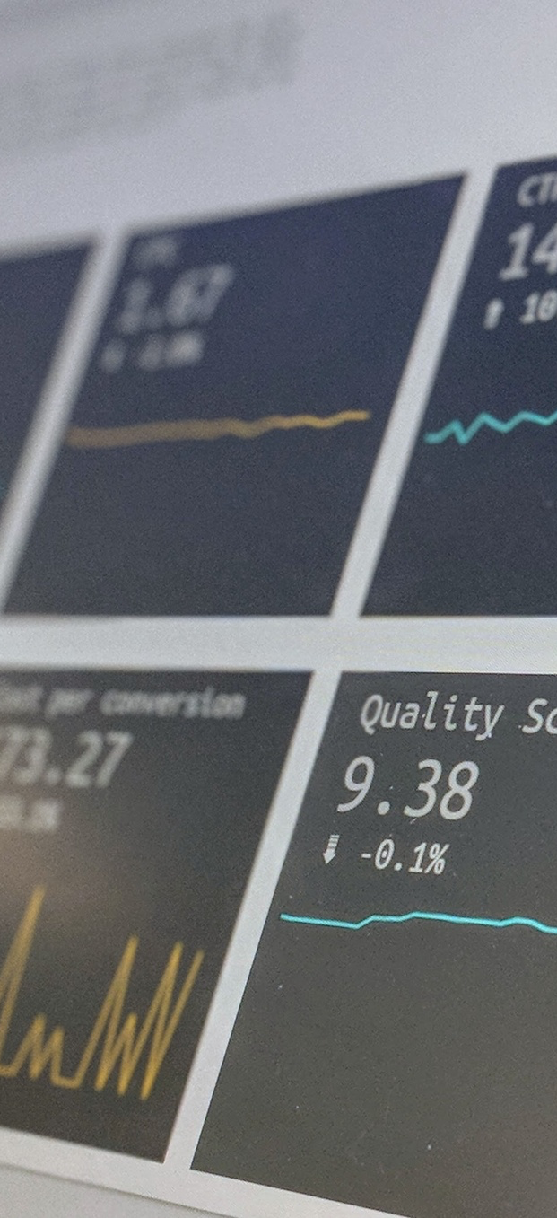
Data Sources
Macro Data
Market Data
U.S. and global inflation
Total returns for equity indices (S&P 500, MSCI World)
GDP growth
Interest rates
Bond indices (Barclays Agg, 10Y Treasuries)
Unemployment
Commodities (oil, gold)
PMI, etc.
FX pairs (DXY, EUR/USD)
(from FRED, OECD, IMF, etc.)

Slide 8
VCMM RT
Reference Materials & Similar Work
“How Do Regimes Affect Asset Prices?”
by Ang & Bekaert (2004)
A foundational paper on regime-switching models and their impact on asset pricing.
https://www.nber.org/system/files/working_papers/w10080/w10080.pdf
“Expected Returns: An Investor’s Guide to Market Forecasting”
by Ilmanen, Antti (2011)
Comprehensive treatment of return drivers under different macro conditions.
Improving U.S. stock return forecasts: A “fair-value” CAPE approac
by Joe Davis
The CAPE ratio’s forecasting power has weakened since 1985 due to its assumption of constant mean reversion. This paper improves forecasts by linking CAPE mean reversion to real yields, inflation, and volatility. The model cuts forecast errors by 50% and predicts ~5% nominal U.S. stock returns.
Forecasting US Equity and Bond Correlation—A Machine Learning Approach
by Boyu Wu, Kevin J DiCiurcio
Based on a systematically determined machine learning feature selection process, the authors find that inflation, alongside real yields, equity volatility, economic growth, and inflation uncertainty, predict changes in correlation dynamics over time.
Equity Factor Timing: A Two-Stage Machine Learning Approach
by Kevin J DiCiurcio, Boyu Wu
The two-stage approach significantly enhances factor prediction outcomes, underlining the importance of determining the market risk regime prior to evaluating factor perfor- mance. This finding highlights the necessity of incorporating market conditions in dynamic factor investment strategies.

Slide 9















Macroeconomics
Machine Learning
Asset Return Forecasting
VCMM
Skills
Portfolio Construction
Regime Modeling

